Slide 1
Forecasting: Price as a Function of Temperature in New York City
Group 6
Brian King, Marc Deluca, Brett Sexton, Nandita Krishnan, Nabilla Harahap

Slide 2

Business Problem
Energy prices present a major & volatile expense for businesses
The Questions We Hope to Answer:
Can historical electricity prices be used to create an accurate forecast to help Energy Consultants advise their clients to reduce uncertainty?
Can the relationship between temperature and energy price be used to make predictions?
Notes:
The ability to predict energy prices helps energy management consultants and supports the development of green technology or sustainable development by allowing developers to determine the amount of money they would save

Slide 3

Stanwich Energy Advisors LLC
Purpose:
Customized Energy Supply Strategies for Business depending on their individual needs
What do their clients ask for?
Protecting against market volatility
The ability to accuracy predict energy consumption
The ability to accurately predict energy budgets
Most Common Contracts:
Fixed rate
Indexed

Slide 4

The Original Dataset
Source
The data set is a combination of historical energy spot prices of INSO Zone J (NYC) and weather conditions
It was provided by Stanwich Energy Advisors LLC
General Characteristics
Hourly time series over 11 years
2010-2022
505811 rows
20 Columns
No missing values
Some extreme outliers that represent weather events, like the polar vortex in 2014

Slide 5
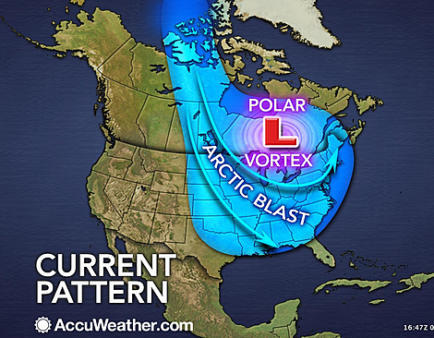
Pre-Processing
The data contained a lot or rows due to the data being hourly
This was impacting execution time
It also made the plots extremely granular and hard to read
Additionally, not all of the original 20 variables were relevant
We reduced the columns down to 3 and then through the aggregation process, went back up to 7
The aggregation process was done using SQL
Transformed the data from hourly to daily
Added additional variables
We then added the “weather dummy” to account for major events that impacted price in the following years:
2014
2018
2021

Slide 6
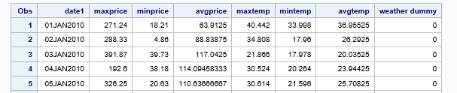
Final Dataset
Daily Time Series
4410 rows, 8 columns
No missing values
Consistent Explanatory Variable:
weather dummy
Three Potential Explanatory Variables (°F):
mintemp
avgtemp
maxtemp
Three Potential Target Variables ($/MWh):
minprice
avgprice
maxprice
Notes:
As a result of pre-processing, this is was the outcome of our final data set. Below you can see what the head of the data looks like and the columns. So we have a daily time series, and with the help of our Professor, we were able to aggregate the prices on a daily basis. Therefore, for each day, we had three methods of price aggregation which are: the maximum price for the day, the minimum price for the day, and the average price of the entire day in Megawatts per hour. These are going to be our Target Variables for each of our models. As for our independent variables, we had temperature in Fahrenheit at the same aggregations as Price. We already had a column for maximum and minimum temperature, so we added a column for average temperature throughout the whole day as well. Because of this, the number of rows has been condensed to 4410 as we are only taking the min, max, and average data for the day and there are no missing values. Lastly, we included a consistent weather dummy variable to help improve our model accuracy and as a result we have 8 total columns including date..

Slide 7
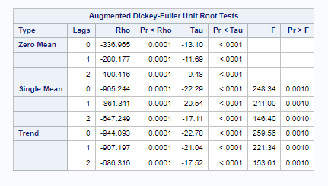
Choosing Model Type - ARIMAX
Relevant Independent Variable - Temperature
Time series with explanatory variable
Need for prewhitening for significant cross correlation
Stationary Target Variable - Price
Take advantage of autocorrelation that may be present in residuals of the regression to improve the accuracy of a forecast
Notes:
When it came to choosing our model type, we had to consider a few factors. Our dataset included a relevant independent variable, which was temperature. Because of this, we decided to go with an ARIMAX model so we can include our exogenous variables, which does add complexity to our model building process, however now our model will be able to capture the influence of these external factors, in this case being temperature. Also, the model takes advantage of any autocorrelation that may be present in residuals of the regression which hopefully will improve the accuracy of our forecasts. Since we have a time series with an explanatory variable, we had to implement pre-whitening the data for the cross correlation function which helped identify which lags of time series for our independent variable temperature, predicts the value of time series for our target variable price. We needed to check for any significant cross correlation, or if either series contains autocorrelation. Then, we had to confirm if our data was stationary to be able to build our model. In order to confirm that it was, we went and performed a unit root test on each of our aggregations for our target variable - price. Below is the result for Average Price. As you can see the p-value for tau and rho are less than .0001 for all the lags indicating that we will reject the null hypothesis since they show significance and therefore our data is stationary. This way we were able to confirm that we can proceed with an ARIMAX model.

Slide 8
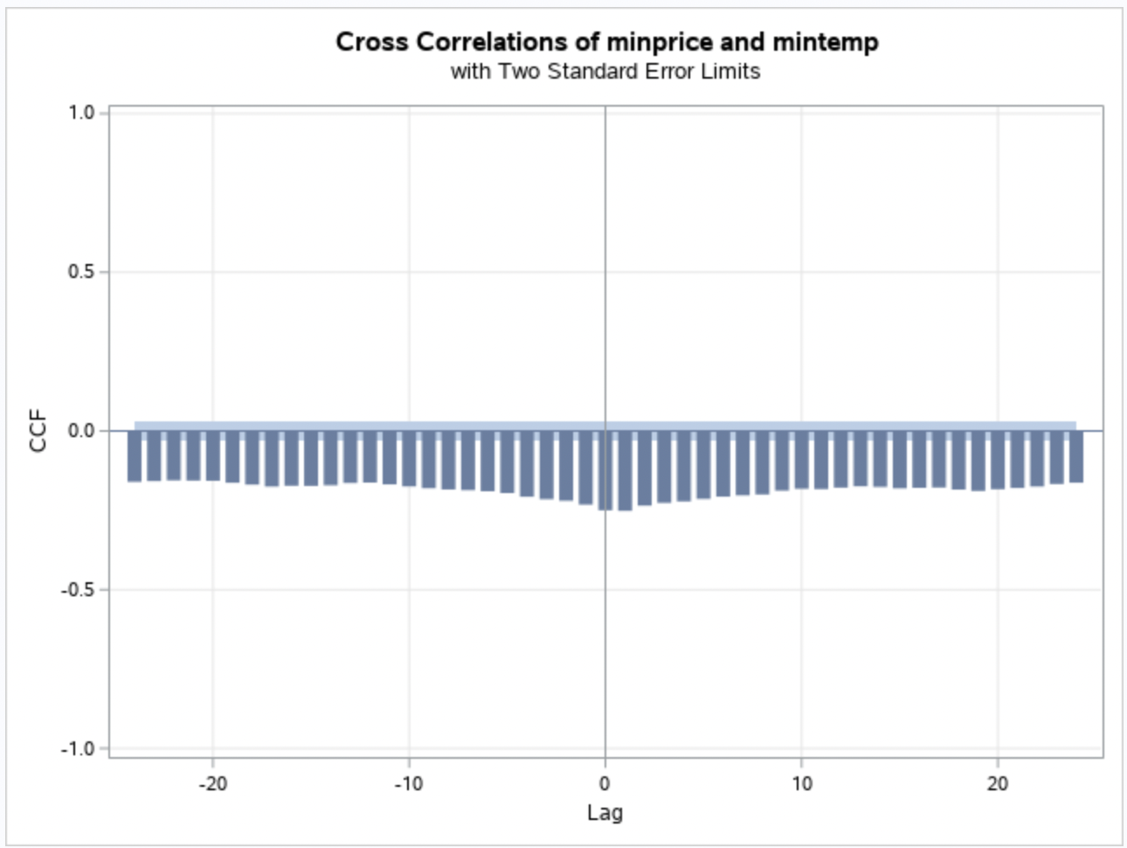
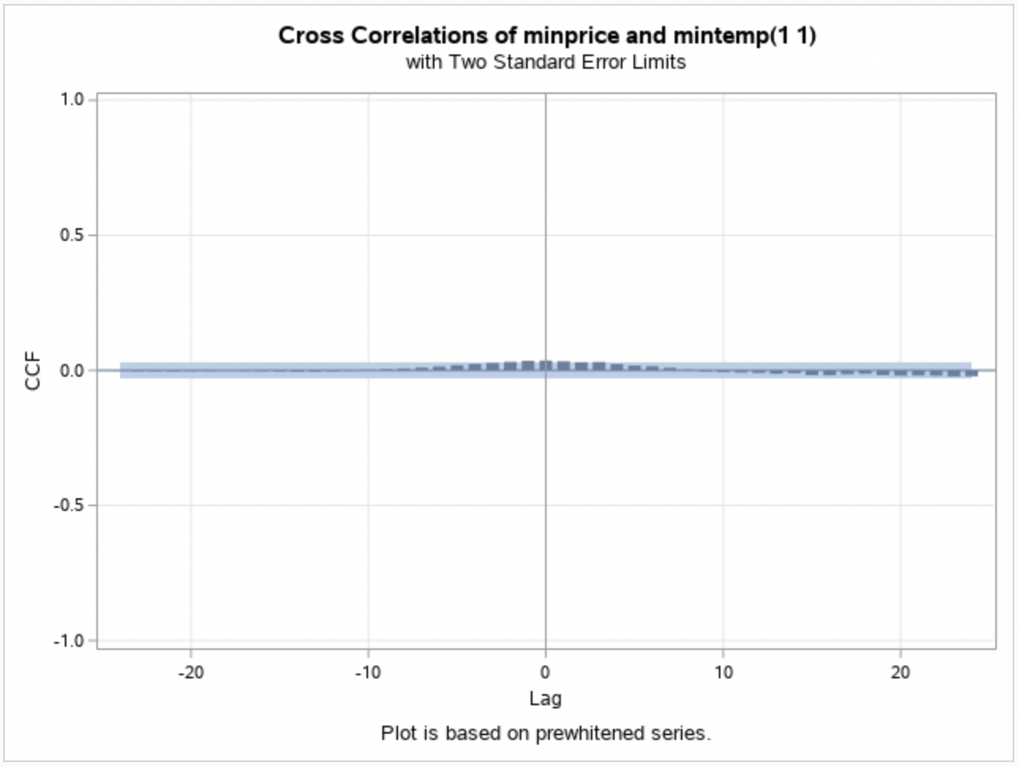
Modeling Approach
Explore the data
Data pre-whitening to handle cross-correlation
Determining the lags from the pre-whitened data
Building an ARIMAX model using the lags, the dependant variable and the two independent variables, which includes the dummy variable - weather_dummy
BEFORE
AFTER
Notes:
- We aim to predict price as a function of temperature. But before running any models, we started our analysis by exploring our data and it immediately became clear that there was a lot of cross-correlation between our independent variable, time, and dependant variable price.
- So our first step was to pre-whiten this data to make it ready for modelling. As visible from these screenshots, pre-whitening made a huge difference in the cross-correlation graphs.
- Now we used this data to determine the lags that can be used while running our final models.
- And our last step was to run the ARIMAX models, with Price as our dependent variable, temperature as our independent variable along with the dummy variable that we created to account for the spikes in the data due to historic events.

Slide 9
Modeling Approach Cont.
Overall there were 9 models constructed to determine the most accurate model that fit the needs of the company and their business problem
We constructed an ARIMAX Model for each aggregation combination:
Avg Temp & Avg Price
Avg Temp & Min Price
Avg Temp & Max Price
Min Temp & Avg Price
Min Temp & Min Price
Min Temp & Max Price
Max Temp & Avg Price
Max Temp & Min Price
Max Temp & Max Price
Notes:
-We performed this process to create 9 models in total, but based on the needs of energy advisors, we determined that the models using minimum and maximum price would be of little use to the advisors and their clients
-Given the two contract types, we concluded that the avg price would be most useful in both situations.
-A higher avg price would indicate periods of generally high demand, which would signal to the companies in an indexed contract to reduce energy usage.
-Additionally avg price could be used to determine the best time to enter into a new fixed rate contract to lock in a low energy rate for an extended period of time.
-So we collectively decided that the avg price would provide the highest actionable insights to the company and then looked at the fit statistics for those three models to determine the one that was best for our business problem, in addition to its accuracy.

Slide 10
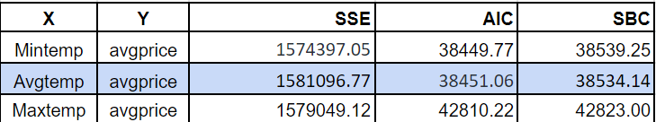
Fit Statistics
Notes:
-Upon reviewing the fit statistics, the forecast plots, and the distribution of the residuals for the three avg price models, we decided to choose the avg temp avg price model as our model of choice.
-The fit statistics among the three models were very similar in SSE, so we looked to the AIC and SBC to see if we could get some more clarity on the accuracy of the models
-As for the AIC, the AIC for max temp avg price was much higher than the other two, so we removed it from the running
-We then looked at SBC as our tie-breaker and the SBC for avg temp avg price was slightly lower than that of min temp avg price

Slide 11
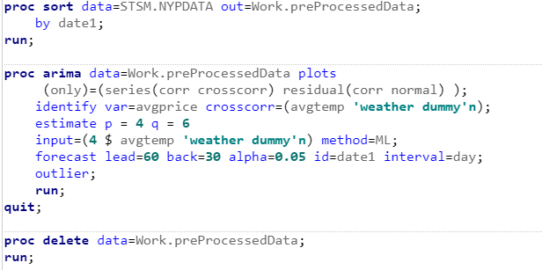
Model Code
Notes:
As for the model code, we did change the lag value that can be seen in the input
We also tried many combinations of values to determine what gave the best outcome as far as white noise probabilities in the residuals
We ended up with a lag of 4 in the input, a p of 4, and a q of 6
Additionally, our d = 0 because we had a stationary model that didn’t require transformation
How we came to these values will be explained further in the coming slides

Slide 12
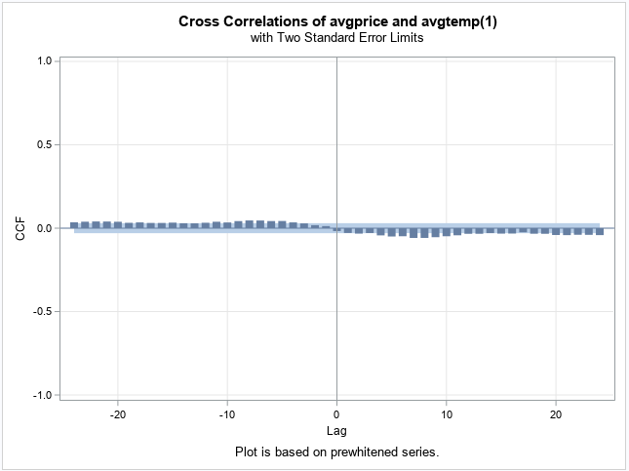
Cross-Correlations
Notes:
To determine the lag value for the input, we reviewed the cross-correlation plot from pre-whitening shown in the slide
We used a lag of 4 in our input because 4 is where the bar becomes significant
This is indicated by the red arrow
We also tried higher values for the lag, as well as multiple lag values within the input because there is some significance after lag 4, but intuitively it doesn’t make sense that the forecasted temperature would be dependent on the temperature from say lag 10 or 12, especially since the lags here represent days
The value of 4 was also the best in terms of white noise probabilities plot

Slide 13
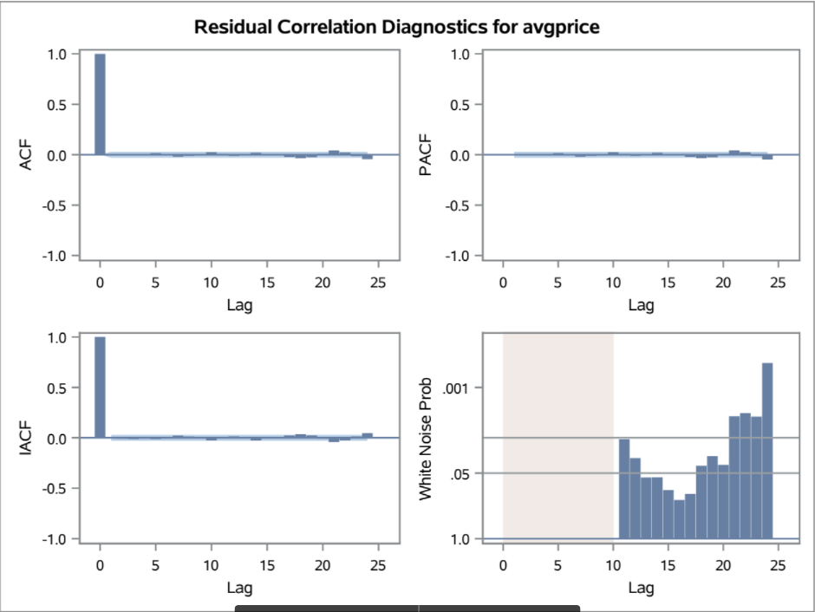
Residual White Noise
Notes:
We want the model to capture as much as possible that is able to be modeled, so we wanted the white noise probabilities to be generally insignificant (close to 1) which tells us that there is a high probability that what remains is just white noise
Given that this is real data, we can’t account for everything, we also can’t expect temperature to be the only determinant of energy prices
Here the white noise does not become extremely significant until lag 21
We also attempted many values for p and q to ensure that what remained was mostly white noise
Again, we used a p = 4 and q = 6

Slide 14
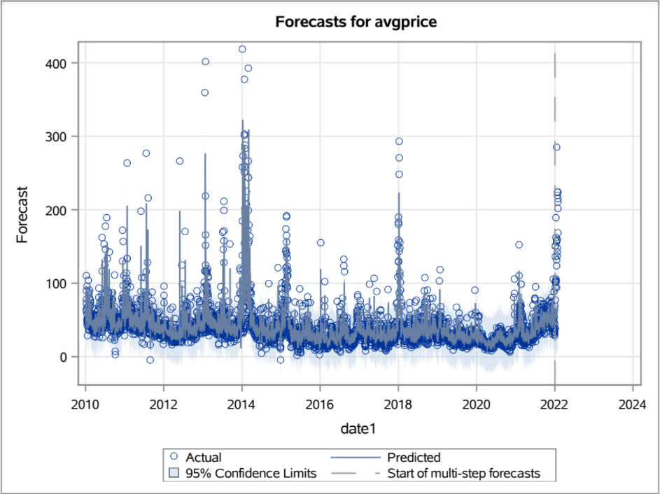
Forecast Plot
Notes:
This is the forecast plot for our model
The plot for all of the data was the best representation of the model
The forecast plot is not perfect and still does not meet some of those extremely high values, however it does account for a lot of volatility and seems to capture past extreme events fairly well

Slide 15
How does this help solve our business problem?
Currently no model or alternative implemented
Short term forecast (less than 30 days):
Used for clients on indexed contracts
Ability to adjust consumption based on forecasted grid demand for lower rates
Long term forecast (multiple months):
Used for clients on fixed rate contracts:
Ability to confidently advise clients on when to enter fixed rate contracts to hedge risk against volatility
Notes:
Right now, there aren’t any models for energy prices implemented, so any progress towards predicting those prices is going to be a big gain. In terms of how those predictions would be useful to business customers there are two categories of forecasts, short term and long term, with short term naturally being more accurate.
For short term forecasts, those would mainly be useful for clients on indexed contracts, which means those clients who opt to pay for a more consistent energy price that’s based on aggregated prices around the area, in this case New York. In that case, short term forecasts would allow us to give those customers a more accurate rate. Also, it would allow us to warn companies if there’s a forecasted price spike, so that those customers could avoid using energy during those times
Long term forecasts are more useful for setting fixed rates. Customers have the option to lock in a certain price for their energy, and a long term forecast would allow us to set that price appropriately. Those fixed prices are great for volatile markets, so a long term forecast that could predict volatility in the energy sector would be a great asset for convincing customers to lock in those prices early.

Slide 16
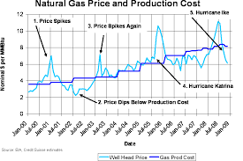
Improvements
Accounting for exogenous stochastic variables
Using a more dynamic dummy variable
Using three models to produce a range
Using logistic regression to predict spikes
Notes:
Additional stochastic variables include gas prices, extreme weather events, global governmental intervention, or global pandemics. Some of these we can’t really include in a model (we’re not going to be able to predict another global pandemic, for example) but we could find time series for fuel and commodity prices that might help our energy price model. An unobserved components model could be useful for doing that.
We used a binary dummy variable for our model, but a dummy variable that could be adjusted for various ranges of spikes could produce a better model.
Over the course of this project, we created models to predict minimum price, average price, and maximum price. We could use those models to create a range of possible energy expense that could be used to evaluate the value of a green renovation project.
Another alternate business problem we could tackled was predicting spikes. Predicting spikes is important because energy management consultants can warn their customers to avoid using energy when prices skyrocket. In those cases, the specific value of the spikes would be less important than just the simple knowledge that there would be a spike. A logistic regression model could predict this.

